Slide 1

Recitation 15 /////

Slide 2
Announcements
HW09 due Thursday (12/02)
Last day of lecture next Monday (12/06)
Next week’s recitation (12/07) will be a final review

Slide 3
Topic Trivia
(True/False) All ADTs can be used as the static and dynamic type of a variable.
(True/False) This is a valid statement: List<String> aList = new ArrayList<>();
(True/False) The addition of a tail field to a LinkedList makes removing the last element a more efficient operation.
(True/False) Adding to the middle of a linked list is O(1) since we just need to create a new node and change references.
(True/False) An ArrayList and a LinkedList are the only ways to implement the List ADT

Slide 4
Topic Trivia
(True/False) All ADTs can be used as the static and dynamic type of a variable.
(True/False) This is a valid statement: List<String> aList = new ArrayList<>();
(True/False) The addition of a tail field to a singly-linked LinkedList makes removing the last element a more efficient operation.
(True/False) Adding to the middle of a linked list is O(1) since we just need to create a new node and change references.
(True/False) An ArrayList and a LinkedList are the only ways to implement the List ADT
False
True
False
False
False

Slide 5
Topics List
ADTs
List ADT
Linked List Intro
Iterable/Iterator

Slide 6
ADTs
ADT - Abstract Data Type → a data type whose creation and modification are constrained to a contract
This contract defines the behavior of data structures, and in Java, these are typically interfaces
Concrete Data Structures implement an ADT
Java has built in ADT and Data structures for you to use.

Slide 7
List
ADT for storing elements in an ordered fashion
Duplicate elements can be added
All elements have an index representing their position
Notable methods:
add(E elem) → adds a new element to a list
remove(E elem) → removes an element from a list
indexOf(E elem) → returns the index of an element, -1 if it doesn’t exist
get(int index) → returns the element at an index
set(int index, E elem) → places element at given position

Slide 8
Intro to Linked Lists
Implements the List<T> interface
Consists of Nodes that hold data and point to the next node in the list
The data field is a generic data type (all nodes hold the same data type)
The next field has type Node and serves as a reference to the next node
Can also make the list doubly linked by adding a reference to the previous node
Without this reference, the list is said to be singly linked
head is a field in the LinkedList class and it points to the first node
(Optional) tail field in the LinkedList points to the last node

Slide 9

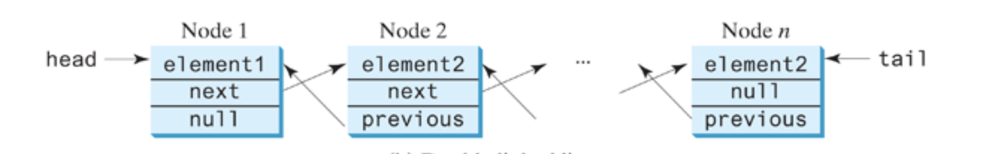
Intro to Linked List
Singly Linked List with Tail Pointer:
Doubly Linked List with Tail Pointer:

Slide 10
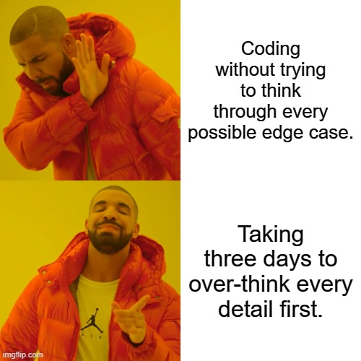
Operations on Linked Lists
We have two fundamental operations we want to perform on our data structure:
Add a Node
Remove a Node
Separate it into 3 cases:
to/fromFront - head
“to/fromMiddle” – how do we get here?
to/fromBack - tail
Beware of edge cases! Think about size of 0 and 1 especially!

Slide 11
Iterating over LinkedLists - Visually
head
tail
Lucas
Melanie
Rachna
Sumit
curr

Slide 12
Iterating over LinkedLists – In (Pseudo) Code
Node curr = list.head;
while (curr != null && curr.next != null) {
curr = curr.next;
}
curr == list.tail; //This expression is true!
The segment of code above would be especially useful if our LinkedList did not have a tail pointer. However, we can still modify it to get to different points in the list.
Nodes of Interest: somewhere in the middle and second-to-last node

Slide 13
addToFront
head
tail
Sumit
Lucas
Melanie
Rachna
temp

Slide 14
“addToMiddle”
Sumit
prev
…
Lucas
Melanie
Rachna
…
temp

Slide 15
addToBack
head
tail
Lucas
Melanie
Rachna
Sumit
temp

Slide 16
removeFromFront
head
tail
Lucas
Melanie
Rachna

Slide 17
“removeFromMiddle”
prev
next
…
Lucas
Melanie
Rachna
…

Slide 18
removeFromBack
tail
head
prev
Lucas
…
Melanie
Rachna

Slide 19
Doubly Linked Lists
Nodes have next AND prev pointers!

Slide 20
AddToFront - DLL
head
tail
Sumit
Lucas
Melanie
Rachna
temp

Slide 21
“addToMiddle” - DLL
Sumit
prev
…
Lucas
Melanie
Rachna
…
temp

Slide 22
AddToBack- DLL
head
tail
Lucas
Melanie
Rachna
Sumit
temp

Slide 23
removeFromFront
head
tail
Lucas
Melanie
Rachna

Slide 24
removeFromBack
tail
head
prev
Lucas
…
Melanie
Rachna

Slide 25
“removeFromMiddle”
prev
next
…
Lucas
Melanie
Rachna
…

Slide 26
Iterator / Iterable
Iterator<E>
Defines the methods that allow for a collection to be iterated through
boolean hasNext()
E next()
Iterable<E>
A collection which can be iterated through
If a collection implements Iterable, you can use a foreach loop on it
Collections implements Iterable
Iterator<E> iterator()
Returns an Iterator object allowing you to iterate over objects of type E

Slide 27
Feedback Time!
The final review recitation typically consists of a massive Kahoot with questions on as many topics as possible along with a massive slide deck with every topic that was covered in this class.
Do you want to follow this format? Or would you rather have your TAs cover specific topics that you struggled with in the past on a more detailed level?
Now is the time to discuss the course of action with your TAs for your specific recitation section for next week! Come to a consensus for your section and your TAs will plan accordingly in order to maximize the review recitation! Each section might be different and that is totally okay!

